Slide 1


Price and Market Analysis on used cars
OLX

Slide 2
About me :
I am Harsha Vardhan P , a BTech graduate with a strong interest in Data Analytics and Data Visualization.
I enjoy working with real-world datasets to extract meaningful insights that enable data-driven decision-making.
I have practical experience in Web Data Extraction, Data Cleaning, and Data Preprocessing using Python and related libraries.
Currently, I am enhancing my expertise in Data Science, focusing on analytical tools, to build a successful career in the analytics domain.
• GITHUB – https://github.com/harshavardhanpoluri13-cloud
•LINKEDIN– www.linkedin.com/in/harsha-vardhn

Slide 3
Objective of the Project :
The objective of this project is to build an end-to-end web-scraping pipeline to collect used-car data from OLX. The project aims to automate the extraction of real car listings, clean and organize the data, and study patterns in pricing, brands, mileage, ownership, and location-based trends in Bengaluru. This project demonstrates how web-scraping can be used to generate a live dataset for real-world market analysis
Build an end-to-end web-scraping pipeline to collect real used-car data from OLX.
Automate extraction of car details like price, brand, mileage, owners, and location.
Clean and organize the scraped data into a structured dataset.
Analyze trends in Bengaluru’s second-hand car market.

Slide 4
Process we followed :
Website Scraped:
OLX Bengaluru – Used Cars Category https://www.olx.in/bengaluru_g4058803/cars_c84
Identify target website pages containing car listings.
Send HTTP requests using Requests with custom headers.
Parse HTML content using BeautifulSoup.
Extract car links from each page.
Visit each product link to gather detailed information.
Use Regex to extract structured text from unstructured strings.
Handle missing or inconsistent fields (NaN handling).
Create a cleaned dataset using lists/dataframes.
Analyze price, mileage, brand patterns, etc.
Interpret insights for market understanding.

Slide 5
Collected information :
Name / Brand (extracted using regex)
Model year
Price (cleaned from currency symbols & formatting)
Location of the seller
Owner count (1st/2nd/3rd owner)
Posting date of the listing
Engine type (Petrol, Diesel, CNG, etc.)
Total trip (mileage in KM)
Transmission (Manual/Automatic)
Variant (specific model configuration)

Slide 6
Data Cleaning Steps:
Removed missing or blank values
Cleaned price values (removed ₹, commas, etc.)
Standardized Total trip formats (converted strings like “77,000” to numeric)
Extracted model year and variant cleanly using regex
Separated location text properly
Handled inconsistent ownership formats (1st owner → 1)

Slide 7
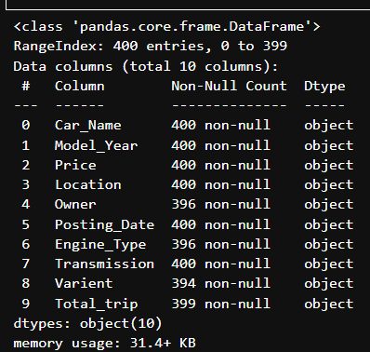
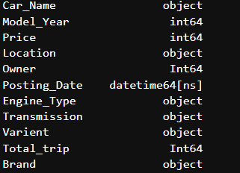
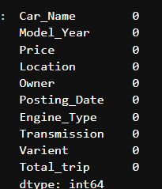
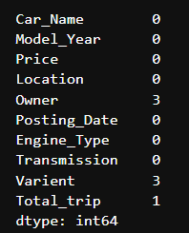
Changing datatype of various columns
Filling of Nan values

Slide 8
Data Manipulation Steps :
Converted numeric columns (price, trip, year) to integers
Extracted brand name from Car_Name
Converted Posting_Date into uniform date format
Created additional columns if needed (e.g., car age = current year − model year)
Grouped data by brand, owner, and location for better analysis

Slide 9
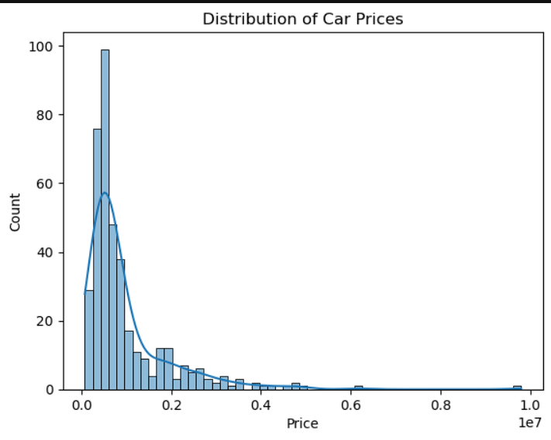
Univariate Analysis Steps :
Distribution of car prices(Numerical (Continuous) -> Numerical (Discrete))
This histogram is showing the distribution of car prices where x-axis represents price.
Blue curve represents the KDE(kernal density estimate).
The majority of second hand cars in this dataset are concentrated at the lower end of the price spectrum.
As the price increases the number of the cars drops sharply.
Here more affordable vehicles are generally more numerous and accessible to wider range of buyers,
where luxury or high end models covers small portion of the market

Slide 10
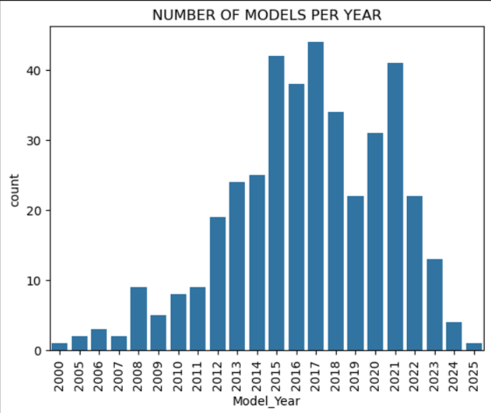
Number of models per year( Numerical (Discrete) ->Numerical (Discrete))
This is a bar chart represent the count of car models for each manufacturing year where x-axis displays the Model Year and the y-axis shows the count of cars from that year.
The chart shows very few listings for cars manufactured in the early 2000s.
The years 2015, 2016, and 2017 show the highest counts of models with bars reaching above 35 and even 40.
There's a sharp decline in the count for the most recent years (2023, 2024, 2025).
This is expected as cars from these years are very new and are less likely to be sold as second-hand.

Slide 11
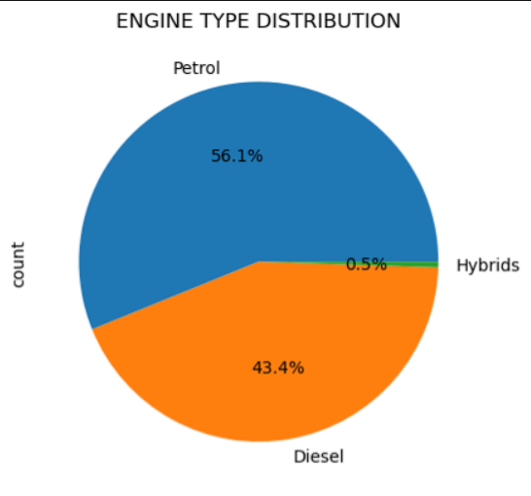
Engine type distribution(Numerical (Continuous) )
This is a pie chart titled "ENGINE TYPE DISTRIBUTION".
It displays the proportion of different engine types (Petrol, Diesel, Hybrids) found in your scraped car dataset.
The chart clearly shows that the vast majority of second-hand cars in your dataset run on either Petrol (56.1%) or Diesel (43.4%).
Hybrid cars represent a very small fraction (0.5%) of the market.
While the number is low, their presence indicates the beginning of a shift towards more fuel-efficient and environmentally friendly options

Slide 12
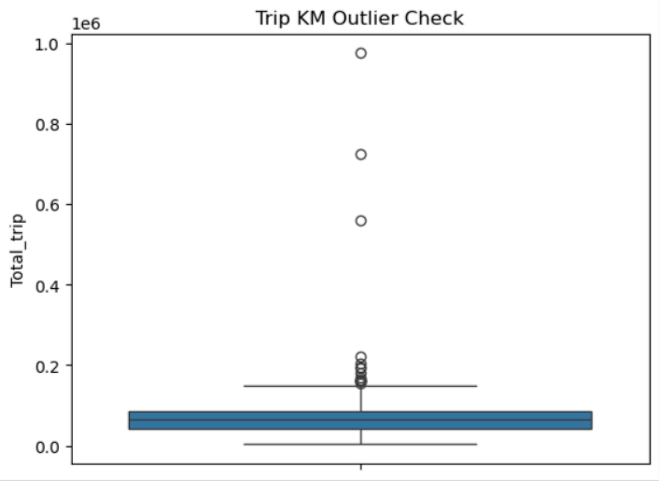
Trip KM outlier check(Numerical (Continuous))
This is a box plot titled "Trip KM Outlier Check".
It visualizes the distribution of the Total_trip (kilometers driven) for the cars of the dataset with a focus on identifying outliers where y-axis represents the Total_trip in kilometers
The main box is very narrow and located at the lower end of the Total trip scale.This indicates that a large proportion of the cars in your dataset have relatively low total trip, likely below 150,000 km.
For a buyer, car with high total trip can imply more wear and tear, potentially leading to higher maintenance costs. For a seller, it might mean a lower asking price.

Slide 13
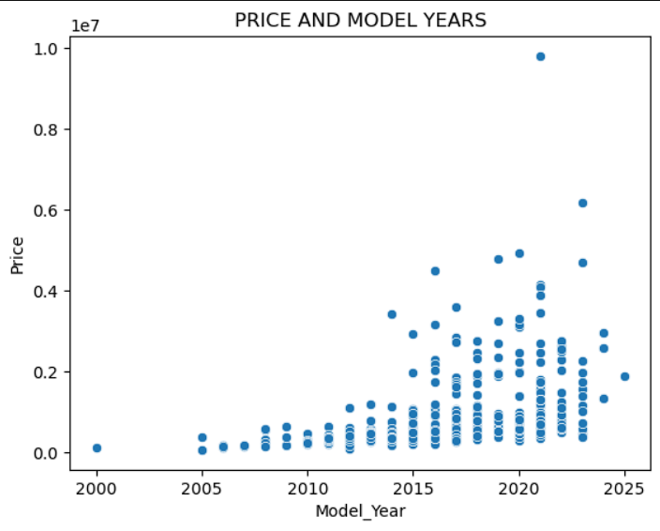
Bivariate Analysis Steps :
Price and Model year(Numerical (Continuous) - Numerical (Discrete))
This is a scatter plot titled "PRICE AND MODEL YEARS".
It illustrates the relationship between the Model year of a car and its Price where x-axis represents the Model year and the y-axis represents the Price.
Newer Cars, Higher Prices: As expected in the used car market there's a clear general trend, newer cars tend to command higher prices.
The cluster of points shifts upwards as you move from left to right on the x-axis.
For older cars (e.g., before 2010), the prices are generally low and have a relatively narrow range

Slide 14
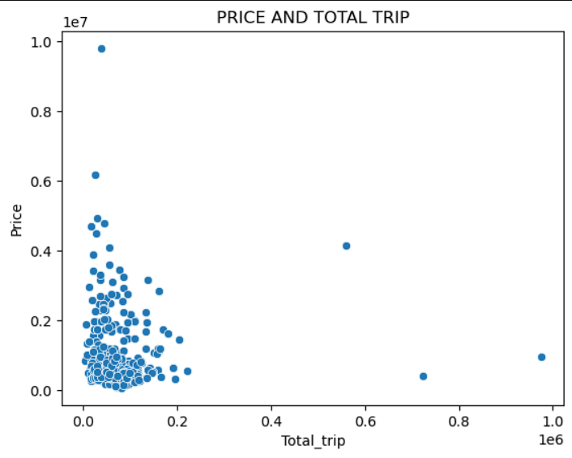
Price and Total trip(Numerical (Continuous) - Numerical (Continuous))
This is a scatter plot showing the relationship between a car's Price and its Total_trip.
Higher Mileage,Lower Price: You can see a general downward slope in the cluster of dots. This means that as the Total_trip increases,the Price of the car generally tends to decrease.
A large number of cars are clustered in the bottom-left corner, indicating many cars have relatively low mileage and are priced affordably.
There are dots high up on the y-axis but close to the left. These represent expensive cars with low mileage, likely premium or luxury vehicles
Conversely, there are dots far to the right (high Total_trip) but low on the y-axis. These are cars that have been driven a lot and are therefore priced much lower

Slide 15
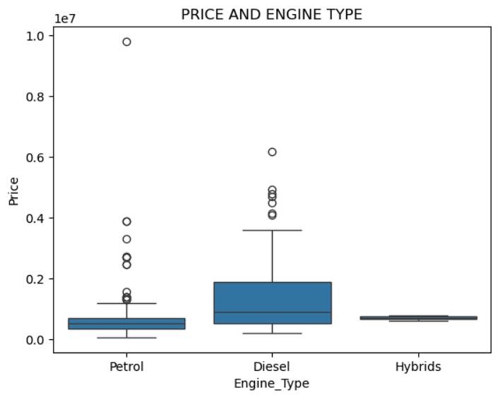
Price and Engine Type(Numerical (Continuous) - Categorical (Petrol, Diesel, Hybrid))
This is a box plot titled "PRICE AND ENGINE TYPE".
It compares the distribution of Price across different Engine Type categories: Petrol, Diesel, and Hybrids.
The majority of petrol cars are concentrated at the lower price range, with the box indicating that 50% of petrol cars are priced relatively low.
Diesel cars generally show a higher median price compared to petrol cars, with the box for diesel being noticeably higher on the price scale. This could be due to diesel engines often being found in larger vehicles (SUVs, MUVs) or premium segments.
Hybrid cars, while very few in number (as seen in the "ENGINE TYPE DISTRIBUTION" pie chart), appear to have a relatively narrow price range in your dataset.

Slide 16
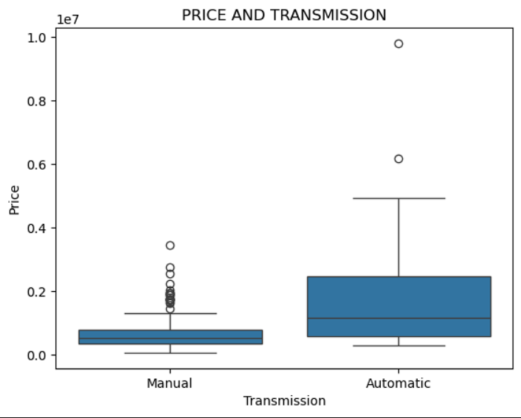
Price and Transmission(Numerical (Continuous) ->Categorical (Manual, Automatic))
This is a box plot comparing the Price distribution for cars with different Transmission types: Manual, Automatic.
The box for manual cars is relatively low on the price scale, indicating that most manual cars are more affordable.
The box for automatic cars is significantly higher on the price scale, showing that automatic cars generally command higher prices.
This plot clearly shows that automatic transmission cars are generally more expensive in the second-hand market compared to manual transmission cars, reflecting their higher initial cost and often higher demand.

Slide 17
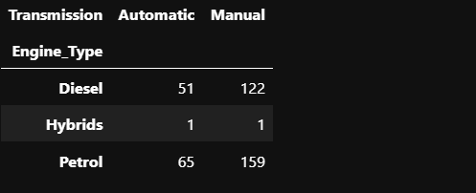
Counts of cars based on transmission(Numerical (Discrete)- Categorical (Manual, Automatic, --) )
This is a table that shows the count of cars based on their Engine Type (Diesel, Hybrids, Petrol) and Transmission type (Automatic, Manual).
Manual Dominance: Across all engine types, manual transmission cars are more numerous than automatic cars in your dataset.
Petrol: 158 Manual vs. 65 Automatic
Diesel: 121 Manual vs. 51 Automatic
Hybrids are Rare: There are only 2 hybrid cars in your dataset, one automatic and one manual.
This confirms their very low representation in the second-hand market.

Slide 18
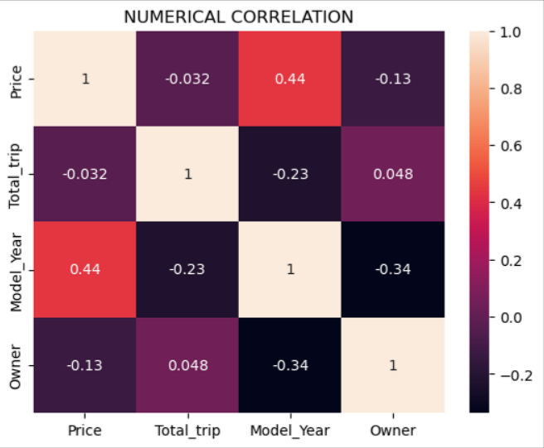
Multivariate analysis -> Heatmap
(Price: Numerical (Continuous),Total_trip: Numerical (Continuous),Model_Year: Numerical (Discrete),Owner: Numerical (Discrete))
1. Model Year strongly affects Price
Correlation = 0.44 (positive)
Newer vehicles tend to have higher prices.
2. More Owners → Lower Price
Correlation = –0.13
Vehicles with more previous owners usually have slightly lower prices.
3. Total Trips has almost no effect on Price
Correlation = –0.032
Trip count does not significantly influence the price.
4. Model Year & Owners
Correlation = –0.34
Newer vehicles typically have fewer past owners.
5. Overall
Price is mainly influenced by Model Year.
Other variables show weak or negligible correlation.

Slide 19
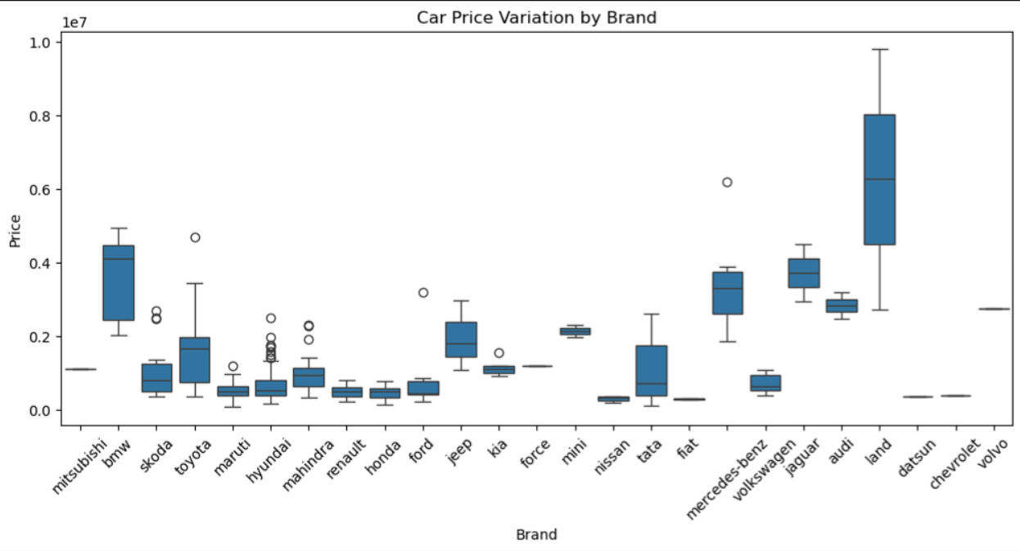
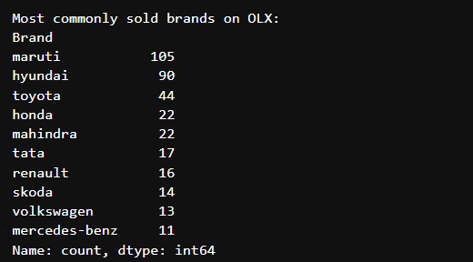
Key Business Question
1. How does car price vary by brand?
2.MOST COMMONLY SOLD BRANDS ON OLX

Slide 20
Conclusion:
Newer cars show significantly higher resale value
Mileage is one of the strongest predictors of price
Cars with 1 owner sell at a premium compared to 2+ owners
Toyota, Honda, and Hyundai tend to maintain stronger resale value
Premium locations have noticeably higher average car prices
Used-car market on OLX is highly varied, making data-driven pricing essential

Slide 21
Experience / Challenges :
Dynamic HTML elements and inconsistent class names
Some listings missing fields like mileage or variant
Regex required careful tuning because OLX formatting varies
Handling NaN values and converting text → numeric values
Extracting clean data from complicated div structures
Parsing posting dates with different formats
Ensuring scraper did not get blocked by OLX
Cleaning the data took more time than scraping

Slide 22

THANK YOU

